Slide 1
Intel® Unnati Industrial Training Program 2024 Integrated Common Services to Common People Institute of Aeronautical Engineering
Vutla Nischitha
22951a6677@iare.ac.in
Faculty Mentor
Dr.M.Nagaraju

Slide 2
Problem Statement
The delivery of essential services such as education, transportation, health, housing, and government services is fragmented and inefficient, posing significant challenges to equitable access for all citizens. Despite advancements in technology and connectivity, many individuals and communities struggle to navigate the complex landscape of service providers and administrative processes.
In education, disparate systems for enrollment, curriculum delivery, and student support services create barriers for students and families, particularly those in underserved communities. Transportation services suffer from disconnected networks, leading to inefficiencies in scheduling, route planning, and accessibility, especially in rural areas.
Healthcare delivery remains disjointed, with separate systems for medical records, appointment scheduling, and prescription management, hindering continuity of care and patient outcomes. Housing services are often siloed, with different agencies managing rental assistance, affordable housing programs, and homelessness services independently, leading to gaps in support and housing instability.

Slide 3
.
Government services, including social welfare programs, licensing, and permit applications, are spread across various departments and agencies, resulting in duplicative paperwork, delays in service delivery, and frustration for applicants.
Moreover, marginalized populations, including rural residents, low-income families, and individuals with disabilities, face heightened barriers in accessing these essential services due to geographical isolation, financial constraints, and lack of digital literacy.
The absence of integrated platforms or systems that consolidate these services exacerbates inequalities and inefficiencies, limiting opportunities for social mobility and economic development. Without a unified approach to service delivery, governments and service providers struggle to meet the diverse needs of their populations effectively.
Addressing these challenges requires a concerted effort to develop and implement integrated service platforms that prioritize user-centric design, interoperability among different service providers, and accessibility considerations. Such platforms should aim to streamline administrative processes, enhance service coordination, and ensure equitable access to essential services for every individual, regardless of their location or socio-economic background.

Slide 4
Unique Idea Brief (Solution)
Proposed Solution: Integrated Service Platform
To tackle the fragmented delivery of essential services and improve accessibility for all citizens, a comprehensive Integrated Service Platform (ISP) will be developed. This platform will be accessible via Android and web applications, providing a unified interface for accessing education, transportation, health, housing, and government services.
This platform offers convenient access to medical appointments, educational materials, transportation schedules, housing support, and government resources through a single, user-friendly interface. By centralizing these services, it promotes efficiency, improves service delivery, and enhances community well-being. This initiative aims to empower individuals by providing comprehensive support systems that address diverse needs and facilitate equitable access to essential services essential for fostering thriving communities.

Slide 5
Features Offered
1.Unified Access Portal:
Users will access all services through a single portal on the Android or web application, eliminating the need to navigate multiple websites or physical offices.
The portal will feature a user-friendly interface with intuitive navigation and search functionalities to help users locate and access services quickly.
2.Interoperability and Data Integration:
The platform will ensure interoperability among different service providers and government agencies, enabling seamless data exchange and collaboration.
Integration with existing government databases and service providers' systems will streamline information sharing and reduce duplication of efforts.

Slide 6
.
3.Integrated Service Modules:
Education: Students and parents can manage school enrollment, access educational resources, and receive updates on academic progress and school activities.
Transportation: Commuters can plan routes, check schedules, and receive real-time updates on transit services. Integration with payment systems allows for seamless fare payments.
Health: Patients can book appointments, access medical records, receive telemedicine consultations, and receive alerts for health screenings and vaccinations.
Housing: Individuals can apply for housing assistance, search for affordable housing options, and receive notifications on housing availability and eligibility criteria.
Government Services: Citizens can apply for permits, licenses, and social welfare benefits. They can track the status of their applications and receive reminders for renewal deadlines.

Slide 7
.
4.Personalized User Experience:
Users will have personalized profiles where they can save preferences, track service usage history, and receive customized recommendations based on their needs and location.
Accessibility features will be incorporated to cater to users with disabilities or those with limited digital literacy.
5.Security and Privacy:
Robust security measures, including encryption and secure authentication protocols, will safeguard users' personal information and transactions.
Compliance with data protection regulations ensures user privacy and confidentiality.
6.Community Engagement and Support:
The platform will include features for community engagement, such as forums, feedback mechanisms, and support channels, to gather user input and address concerns promptly.

Slide 8
Process flow
Planning and Stakeholder Engagement: The process begins with thorough planning and extensive stakeholder engagement. This involves assessing the existing infrastructure and service delivery models for each sector—education, healthcare, transportation, housing, and government services—to identify strengths, weaknesses, and areas for improvement. Stakeholder engagement includes consultations with government agencies, service providers, community organizations, and representatives of the public to gather insights into community needs and expectations.
Designing a Centralized Platform: A key component of the process is designing and developing a centralized platform that integrates these diverse services. The platform aims to streamline access and delivery, utilizing digital technologies such as cloud computing, data analytics, and mobile applications. This platform should be designed with a user-centric approach, ensuring ease of navigation and accessibility across various devices and connectivity levels. User experience testing and iterative design are crucial to refine the platform based on feedback from pilot projects and stakeholders.

Slide 9
.
Partnerships and Resource Optimization: Successful implementation relies on forging partnerships between public and private stakeholders. These partnerships help optimize resource allocation, leverage expertise, and enhance service delivery efficiency. For instance, collaborating with private transportation providers can improve accessibility to public transit, while partnerships with healthcare providers can enhance the delivery of medical services within the integrated framework.
Phased Deployment and Pilot Projects: The implementation strategy involves phased deployment starting with pilot projects in select communities or regions. This approach allows for testing the integrated system on a smaller scale, identifying challenges, and refining processes before scaling up to broader implementation. Pilot projects provide valuable insights into user behaviors, system performance, and operational dynamics, which inform adjustments and improvements.

Slide 10
.
Training and Capacity Building: Training programs are essential for equipping service providers and administrators with the skills and knowledge to effectively utilize the integrated system. Training modules should cover system navigation, data management protocols, customer service standards, and troubleshooting procedures. Continuous capacity building ensures that stakeholders are empowered to deliver high-quality services within the integrated framework.
Monitoring, Evaluation, and Iterative Improvement: Continuous monitoring and evaluation are critical throughout the implementation process. Key performance indicators (KPIs) are established to measure the effectiveness, efficiency, and impact of the integrated services. Regular feedback loops and data analytics help identify areas for improvement, address emerging challenges, and capitalize on opportunities for enhancement. Stakeholder feedback, user satisfaction surveys, and performance metrics guide iterative improvements to the platform and service delivery protocols.

Slide 11
.
Maintenance and Sustainability: Ensuring the long-term sustainability of the integrated system requires ongoing maintenance, updates, and adaptation to evolving community needs and technological advancements. This includes cyber security measures to safeguard sensitive data, scalability to accommodate growth, and flexibility to integrate new services or adjust existing ones based on changing priorities.
In conclusion, implementing a unified system of integrated services involves a comprehensive process that spans planning, stakeholder engagement, technological integration, pilot testing, training, monitoring, evaluation, and ongoing refinement. By leveraging partnerships, digital innovation, and user-centric design, communities can achieve equitable access, improved service delivery, and enhanced quality of life for all members of the population.

Slide 12
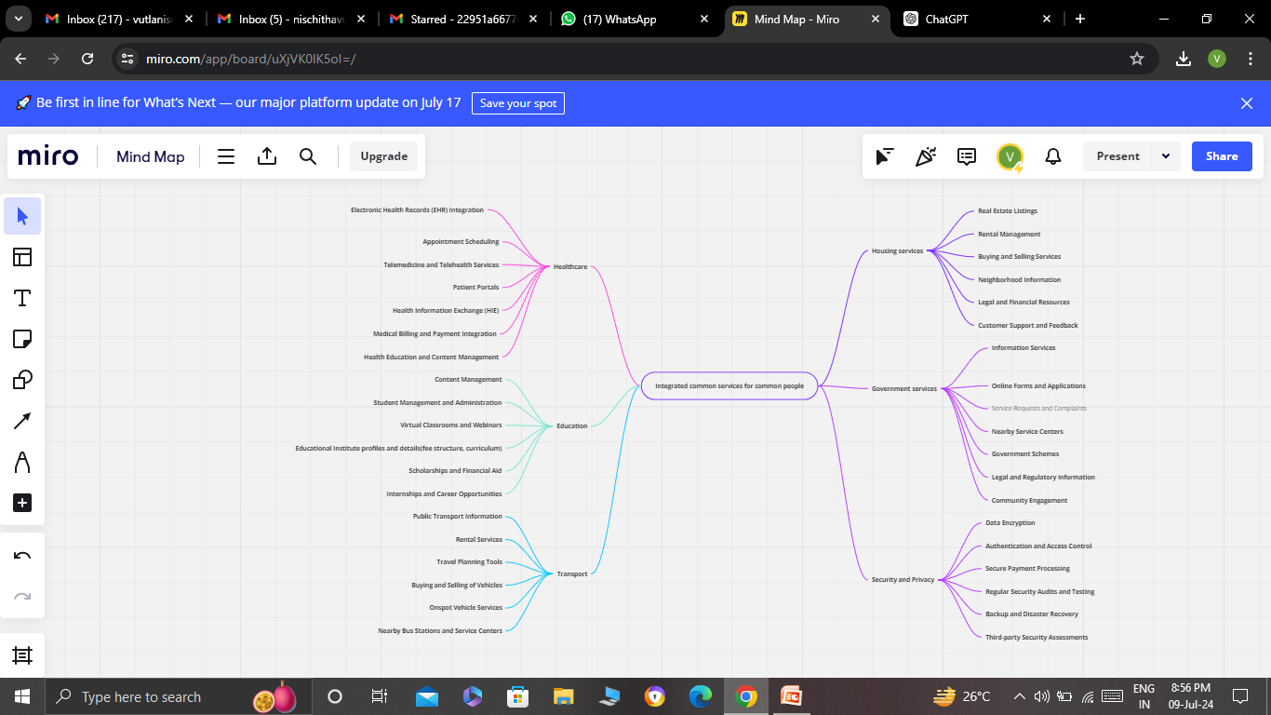
Architecture Diagram

Slide 13
Technologies used
Cloud Computing: Cloud infrastructure (e.g., Amazon Web Services, Microsoft Azure, Google Cloud Platform) provides scalability, flexibility, and cost-efficiency for hosting the centralized platform and storing large volumes of data securely. Cloud services also support data analytics, machine learning, and AI applications.
APIs and Microservices: Application Programming Interfaces (APIs) enable communication and data exchange between different service modules and the centralized platform. Using microservices architecture allows for modular development, deployment, and scaling of individual service components.
Data Integration and Interoperability: Technologies like Enterprise Service Bus (ESB), message brokers (e.g., Apache Kafka), and data integration platforms (e.g., MuleSoft, Informatica) facilitate seamless integration of disparate data sources and systems, ensuring interoperability across different services.

Slide 14
.
Big Data and Analytics: Big data technologies (e.g., Hadoop, Spark) and analytics tools (e.g., Tableau, Power BI) enable organizations to analyze large volumes of data generated by various services. Predictive analytics and data-driven insights help optimize service delivery, resource allocation, and decision-making.
Mobile and Web Applications: User interfaces are developed using technologies such as HTML5, CSS, JavaScript frameworks (e.g., React, Angular, Vue.js) for building responsive web applications. Mobile apps (iOS, Android) provide users with convenient access to services and real-time information.
Cybersecurity Solutions: Robust cybersecurity measures are essential to protect sensitive data and ensure compliance with privacy regulations (e.g., GDPR, HIPAA). Technologies include encryption algorithms, firewall systems, intrusion detection/prevention systems (IDPS), and secure authentication mechanisms.

Slide 15
.
IoT (Internet of Things): IoT devices and sensors can be utilized in transportation (e.g., smart city initiatives for traffic management), healthcare (e.g., remote patient monitoring), and housing (e.g., smart home technologies) sectors to collect real-time data and improve service delivery.
Blockchain: Blockchain technology can enhance transparency, security, and trust in transactions and data exchanges within government services (e.g., identity management, land registry) and financial transactions related to housing.
Artificial Intelligence (AI) and Machine Learning (ML) : AI/ML algorithms can automate processes, optimize resource allocation, and provide personalized recommendations in healthcare (e.g., diagnostic support), education (e.g., adaptive learning platforms), and government services (e.g., chatbots for citizen queries).
Geospatial Technologies: Geographic Information Systems (GIS) and mapping technologies are used in transportation (e.g., route planning), housing (e.g., urban planning), and emergency services (e.g., disaster response planning).

Slide 16
Team members and contribution:

Slide 17
Conclusion
In conclusion, the integration of modern technologies into a unified system of services—encompassing education, healthcare, transportation, housing, and government services—presents a transformative opportunity to enhance accessibility, efficiency, and quality of life for communities.
By leveraging cloud computing, organizations can achieve scalability and cost-effectiveness in hosting and managing the centralized platform. APIs and microservices facilitate seamless communication and data exchange between disparate service modules, promoting interoperability and streamlined service delivery. These technologies not only connect systems but also empower stakeholders with real-time access to information and services via user-friendly web and mobile applications.
Big data analytics provides actionable insights that drive informed decision-making, optimize resource allocation, and personalize service delivery. Meanwhile, robust cybersecurity measures ensure data privacy and protect against cyber threats, fostering trust and compliance with regulatory standards.

Slide 18
.
The inclusion of IoT devices and sensors enhances service responsiveness and efficiency, particularly in transportation and healthcare sectors, while blockchain technology ensures transparency and integrity in transactions within government services and housing sectors.
Artificial intelligence and machine learning algorithms automate routine tasks, improve service responsiveness, and enable predictive analytics to anticipate community needs proactively. Geospatial technologies provide spatial insights for urban planning, transportation routing, and disaster response planning.
Ultimately, the successful implementation of these technologies supports a holistic approach to community development, where integrated services are not only accessible but also responsive to diverse needs and challenges. Continuous evaluation and adaptation are crucial to refining these systems, ensuring they evolve alongside technological advancements and changing community dynamics.
In essence, the adoption of modern technological solutions represents a paradigm shift towards more efficient, equitable, and sustainable service delivery frameworks, enhancing the overall well-being and satisfaction of citizens across various facets of their daily lives.

Slide 19

.

